Slide 1


Great Climates, Big Cities?
Kansas Populations: a look at employment and unemployment, correlation between poverty and household income, wealth, weather, migration

Slide 2
Topic: Unemployment Rates and Poverty Data
Question
find by numbers how are levels of employment and unemployment in Kansas to recognize how extent of opportunities or not?
what the correlation between poverty rate and household income?
Discovery process

Slide 3

Data Analysis Approach
Focus on Kansas City.
Focus on population of poverty, and household income from USDA.
Use poverty estimates for the U.S., States, and counties, 2018 dataset from the USDA.
This Photo by Unknown Author is licensed under CC BY-SA

Slide 4
Documentation
https://public.opendatasoft.com/
https://www.ers.usda.gov/data-products/county-level-data-sets/download-data/
Unemployment and median household income for the U.S., States, and counties, 2000-19
Poverty estimates for the U.S., States, and counties, 2018

Slide 5
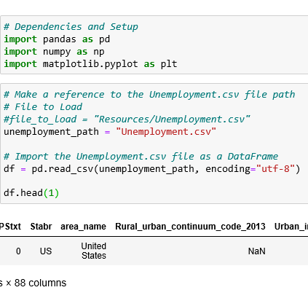
Let’s go into coding!
Pandas as pd
numpy as np
Matplotlib.pyplot as plt

Slide 6
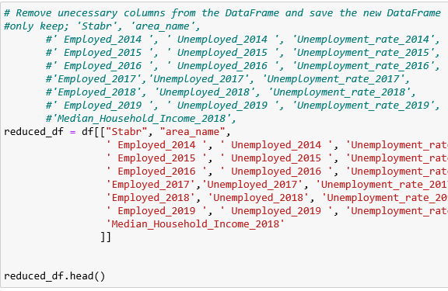
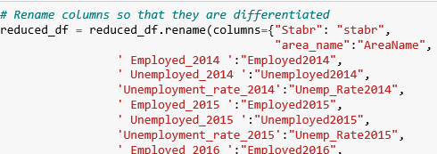
Clean up unnecessary columns and rename

Slide 7
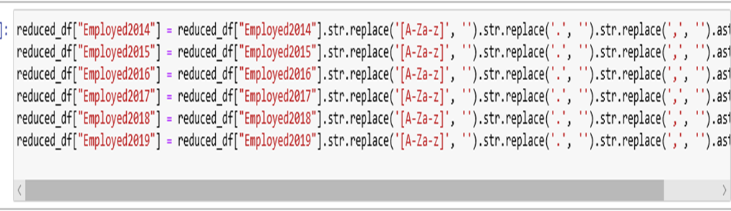
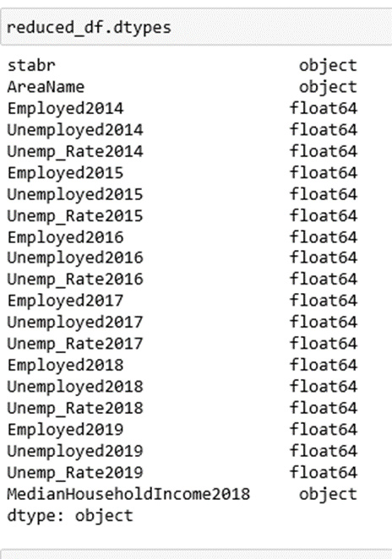
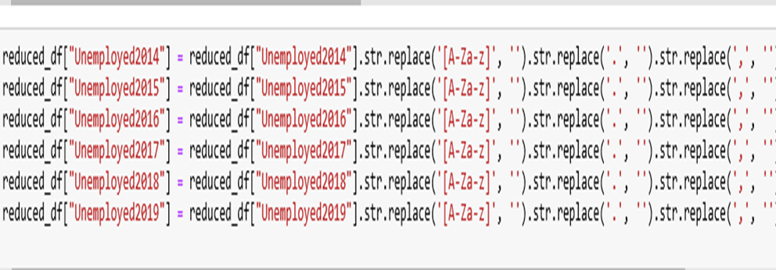
Obstacles:

Slide 8
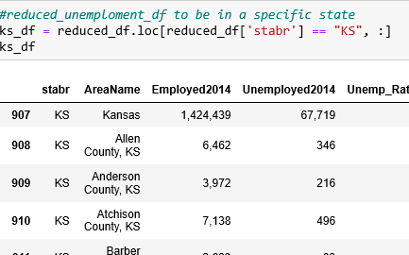
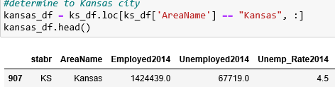
Determine specific row, Kansas
Determine specific column, KS

Slide 9
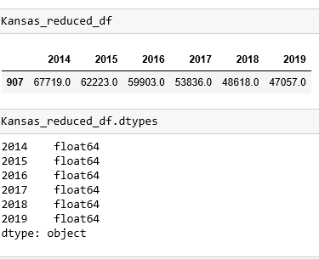
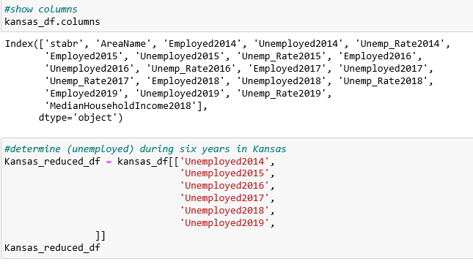
Make sure columns names and numbers is numeric

Slide 10
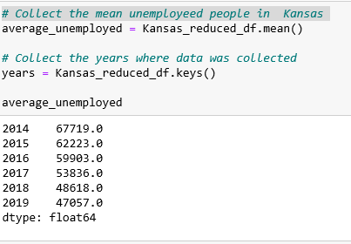
Calcolate the means for each employeed and unemployed .

Slide 11
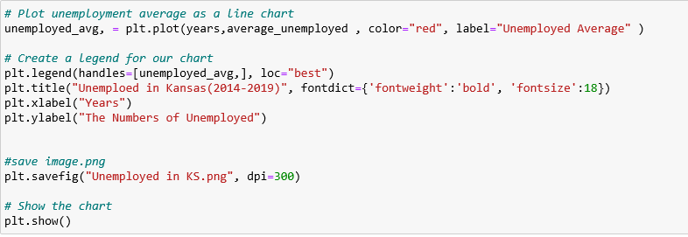
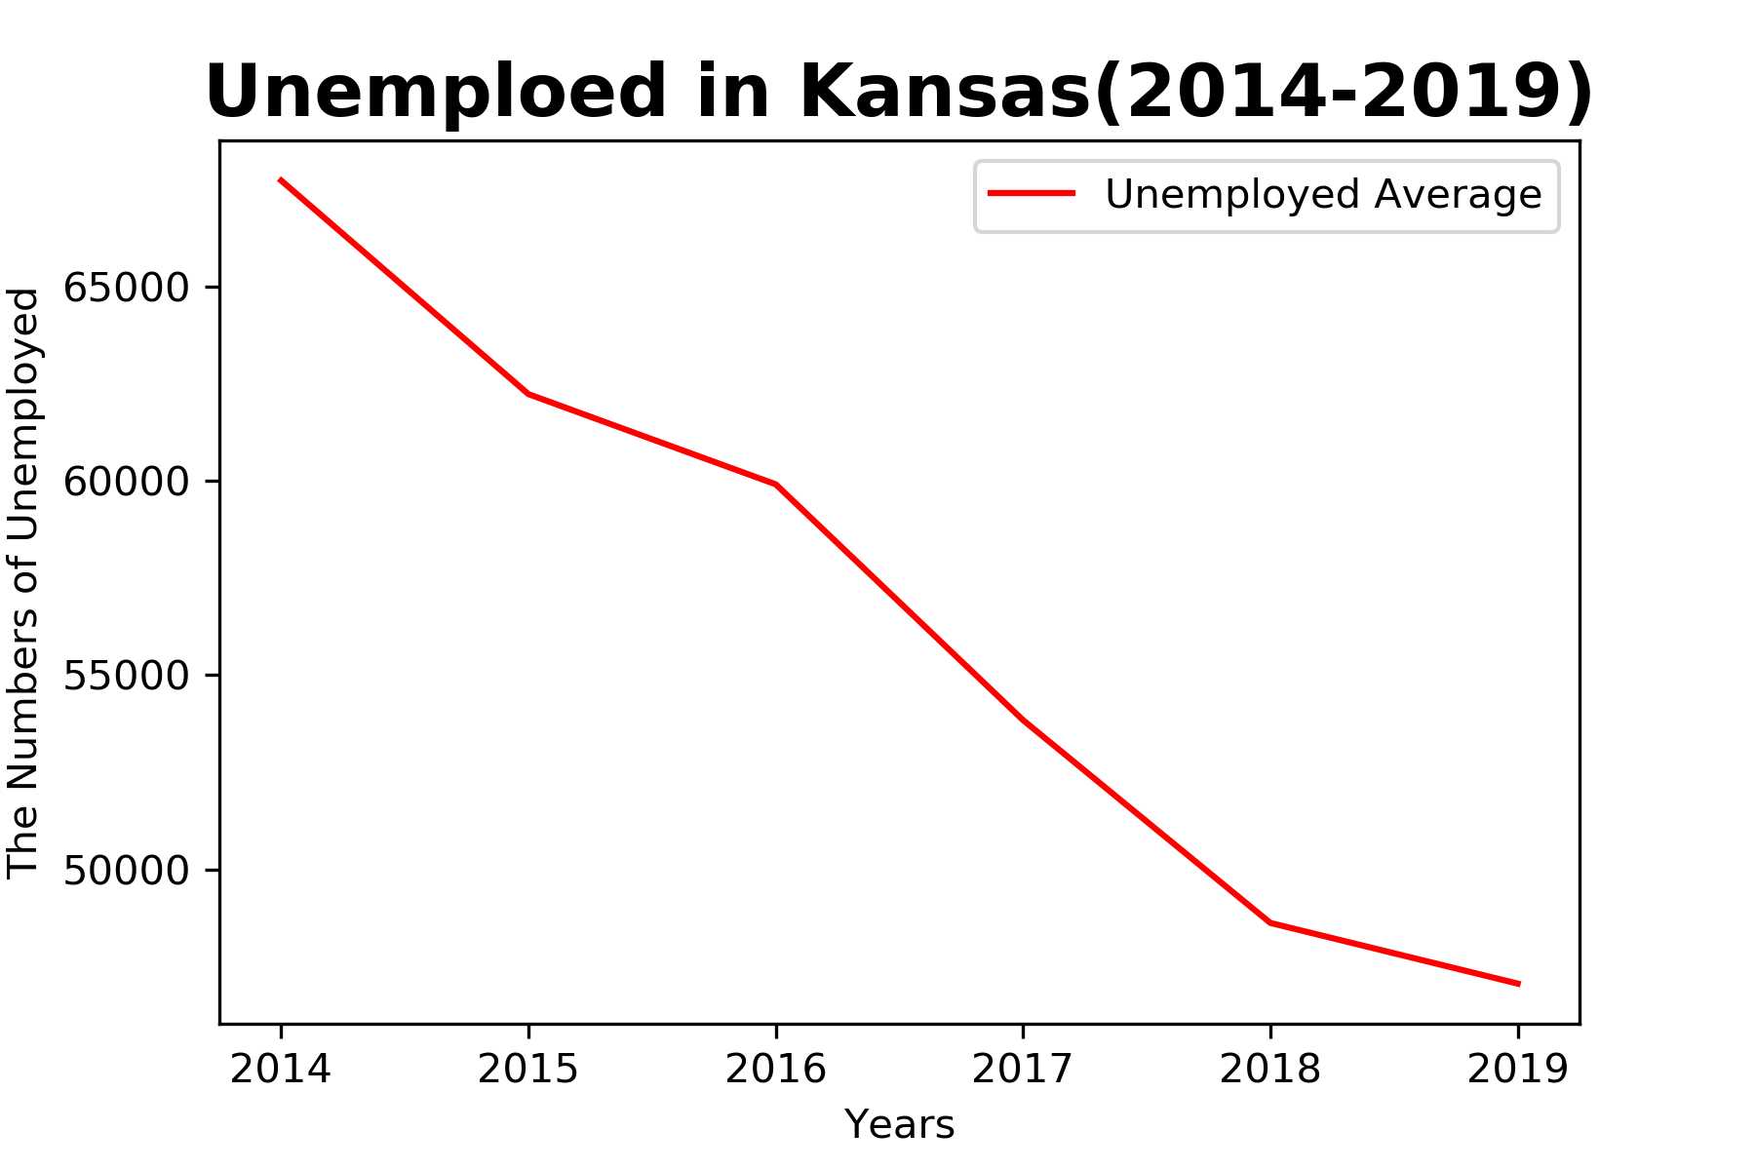
Create line plot:
Unemployed in Kansas from 2014 -2019 :

Slide 12
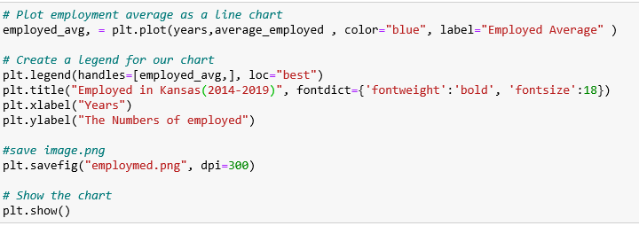
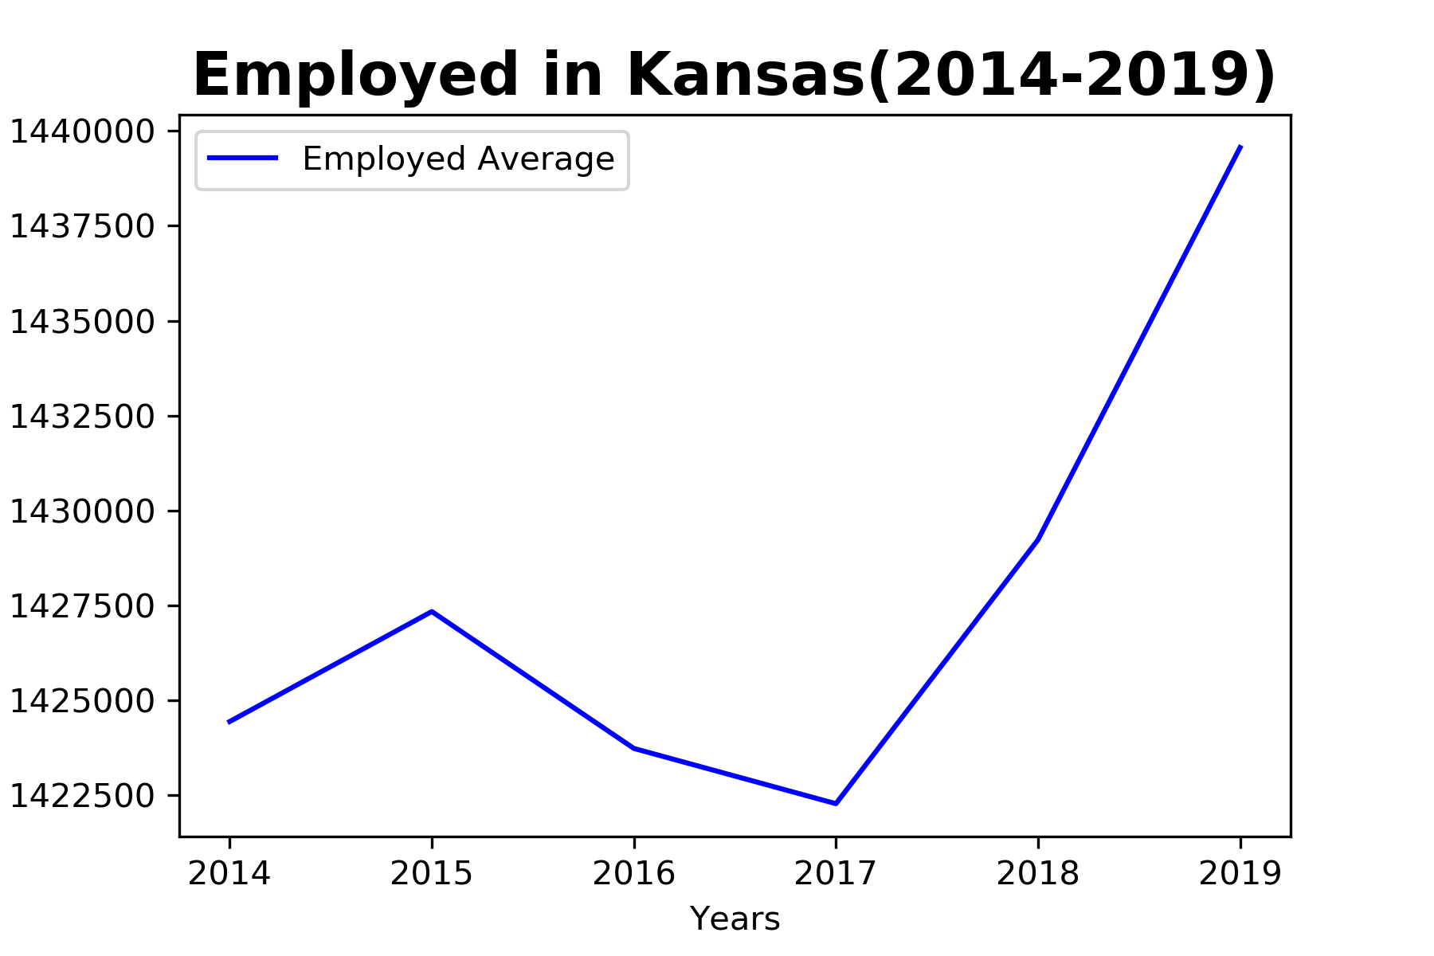
Employed in Kansas during six years ago: (2014-2019):

Slide 13
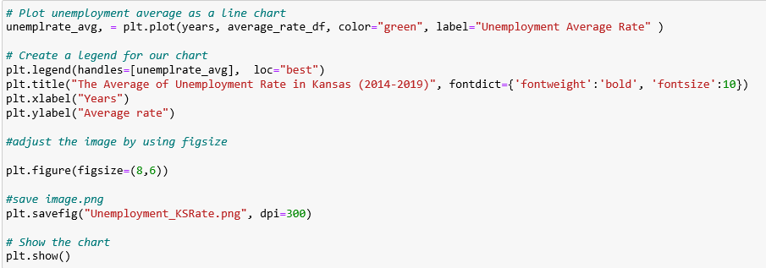
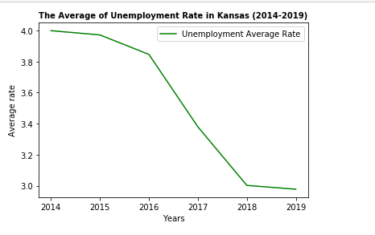
The average of unemployment rate :

Slide 14
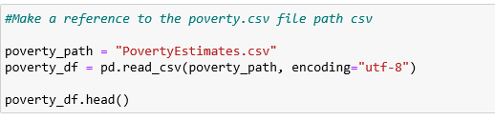
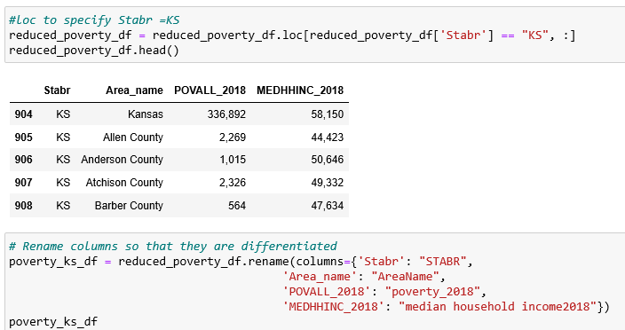
The corolation between poverty and median household income in KS:

Slide 15
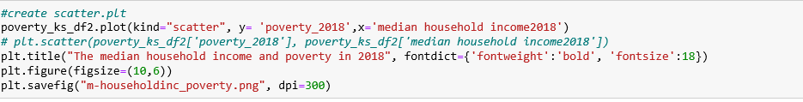
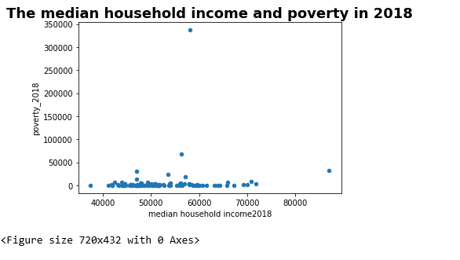

Slide 16
Is there a correlation between unemployment and migration against humidity and temperature over time?
There Are Many Factors Affecting Unemployment
Are there transparent trends regarding migration, unemployment, temperature and humidity?
Data Analysis Approach
Focus on Kansas for Unemployment and Migration data (2018 Census)
Used temperature and humidity data from OpenWeather API (2019 Census, Current API)

Slide 17
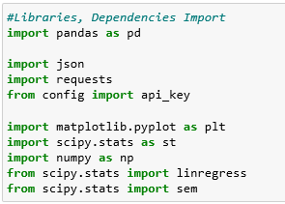
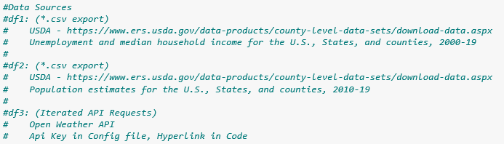
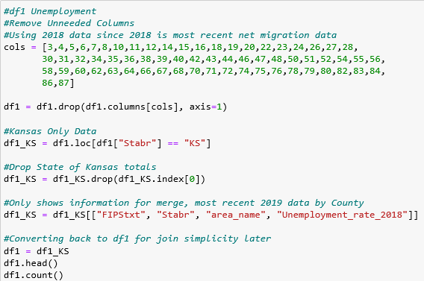
Census Data

Slide 18
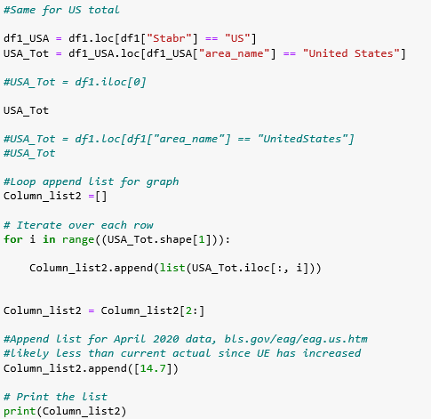
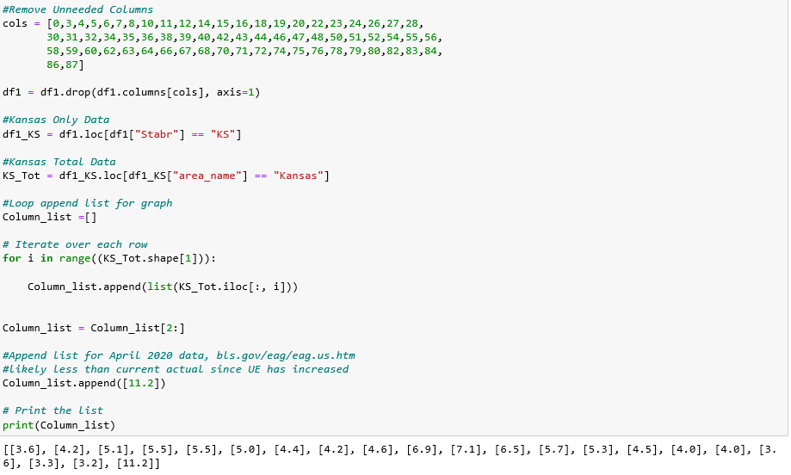
Census Data

Slide 19
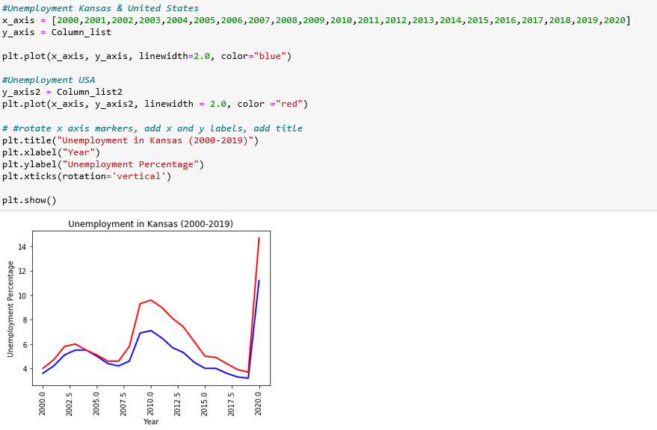
Census Data

Slide 20
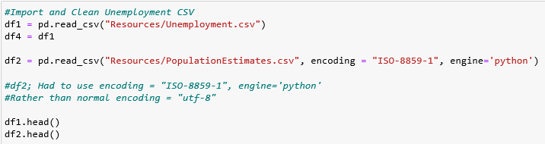
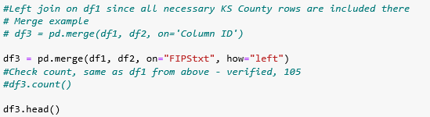
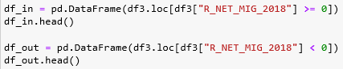
Census Data

Slide 21
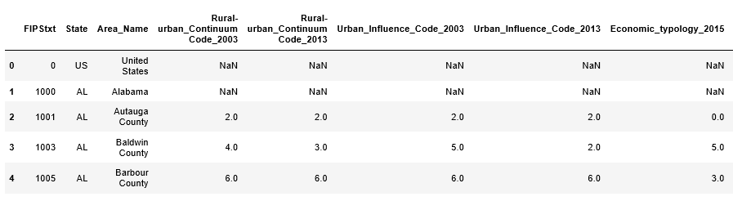
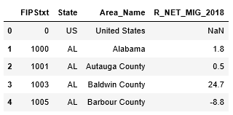
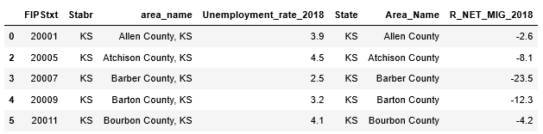
Census Data

Slide 22
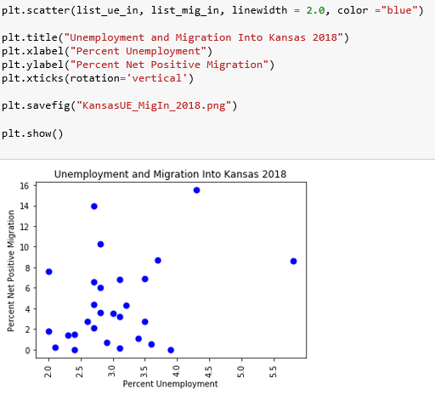
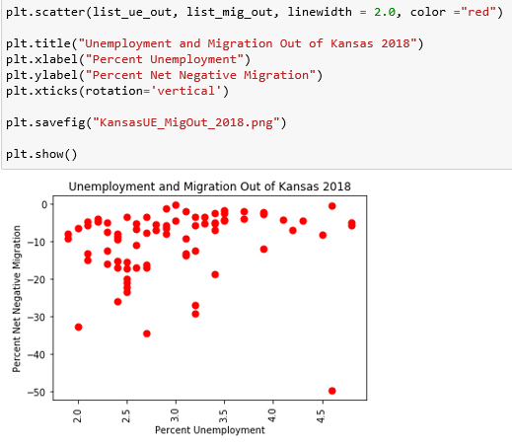
Census Data

Slide 23
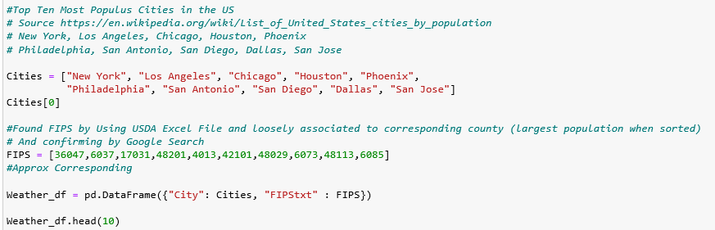
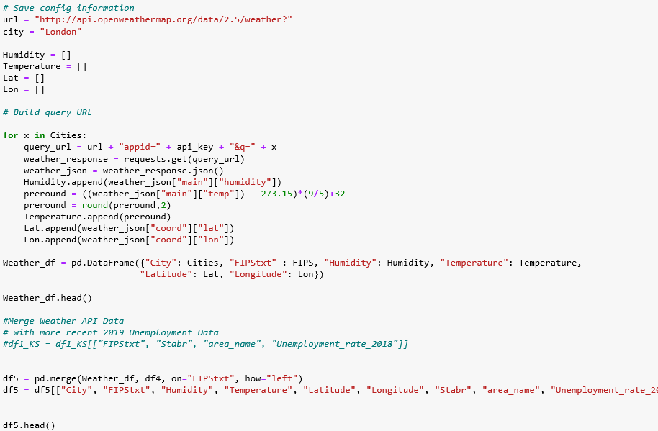
Census & Open Weather API Data

Slide 24
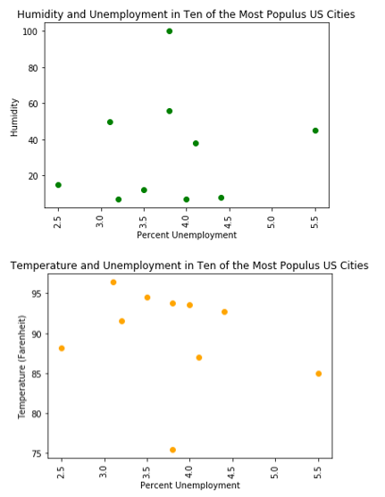
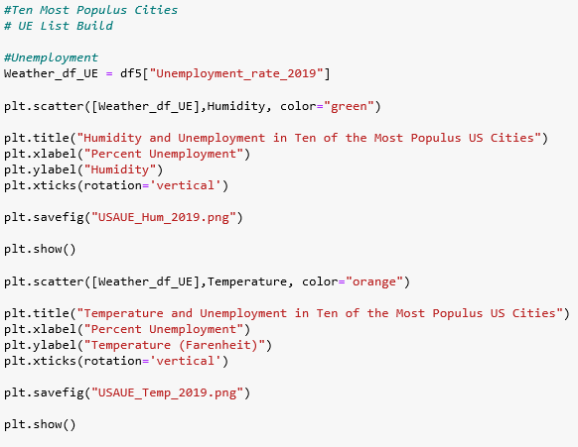
Census & Open Weather API Data

Slide 25
Conclusions
Kansas unemployment is historically lower than the national average.
The is no visible correlation between unemployment and migration in Kansas in 2018.
There is no visible correlation between temperature and humidity in the ten most populus cities in the United States (current Open Weather API data & 2019 annual Census data).

Slide 26
Data limitations and Recommendations
Limitations:
Data is limited to older Kansas annual historical data and current Open Weather API data. The scope is too small to conclusively say there is no correlation across a larger dataset.
Recommendations:
Future directions include completing the regression on the scatter plots, exploring big data (expanding scope), looking at connections to demographics and other variables while utilizing different chart types beyond scatter plots.
Challenges:
Historical weather data: Much time was spent Google searching to find appropriate historical weather data.
Uploading data. Importing CSV error was resolved by digging into Google and StackOverflow.

Slide 27
Is the temperature of a city metropolitan area hottest downtown?
Observations made in Sacramento, CA
Downtown temperatures always seemed hotter than surrounding areas.
Data Analysis Approach
Focus on Kansas City, MO and the surrounding metropolitan area
Use temperature data from OpenWeather API
Use population data from the Census Bureau

Slide 28
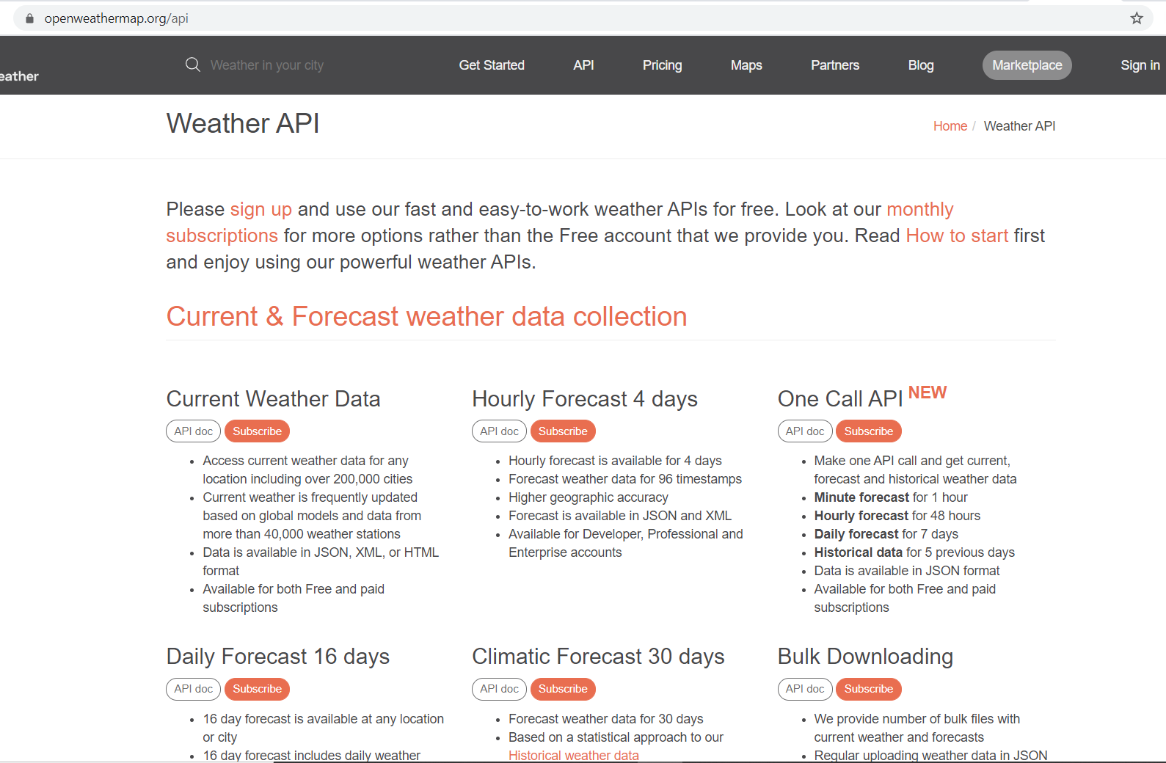
Data source used for gathering temperature data was the Open Weather API
5 day history

Slide 29
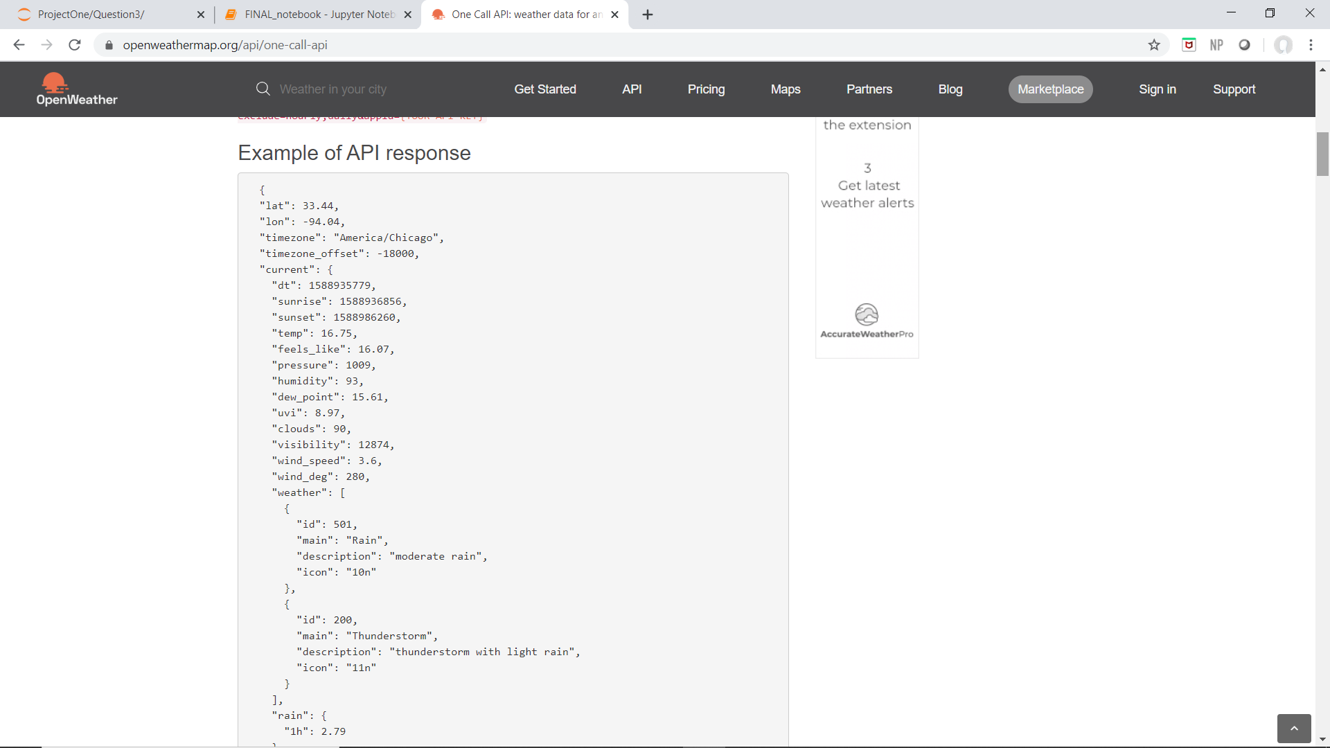
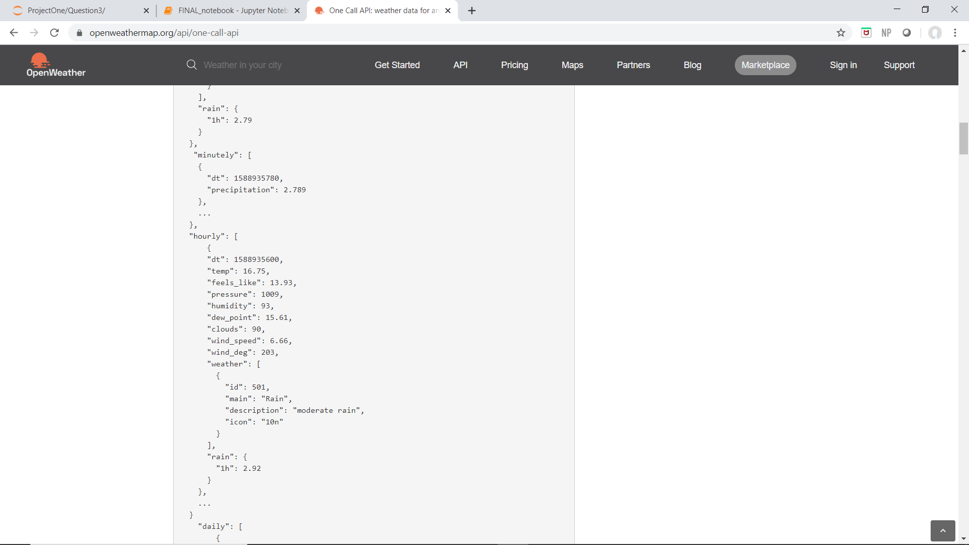
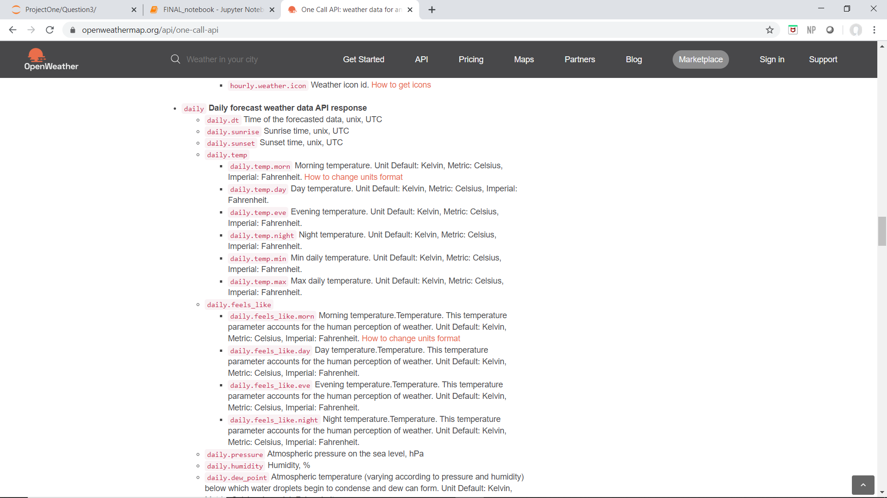
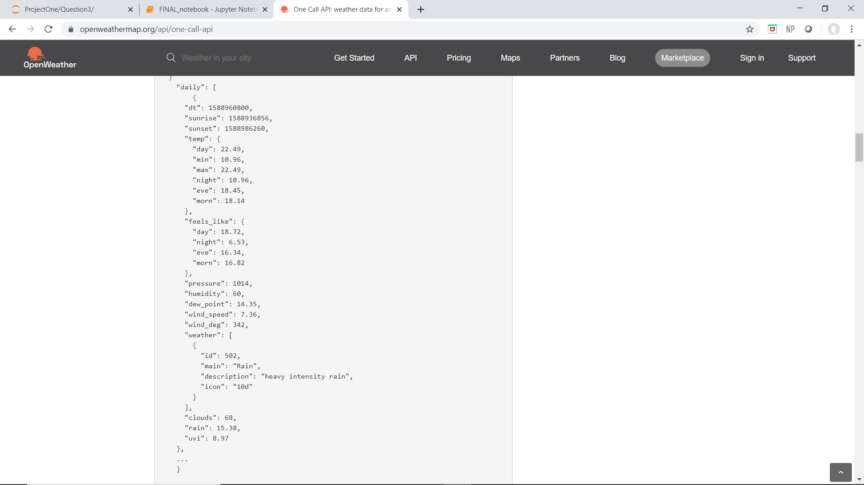
Open Weather API
Daily High Temp

Slide 30
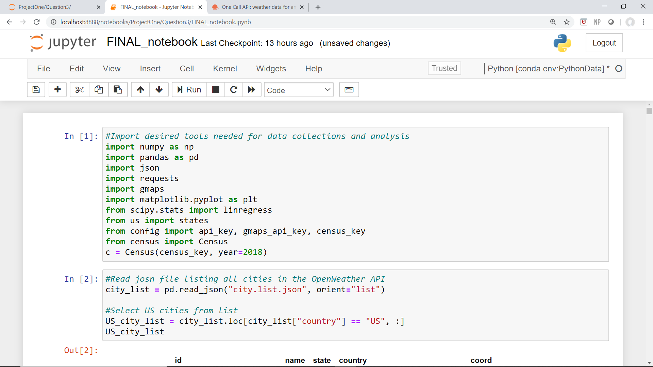
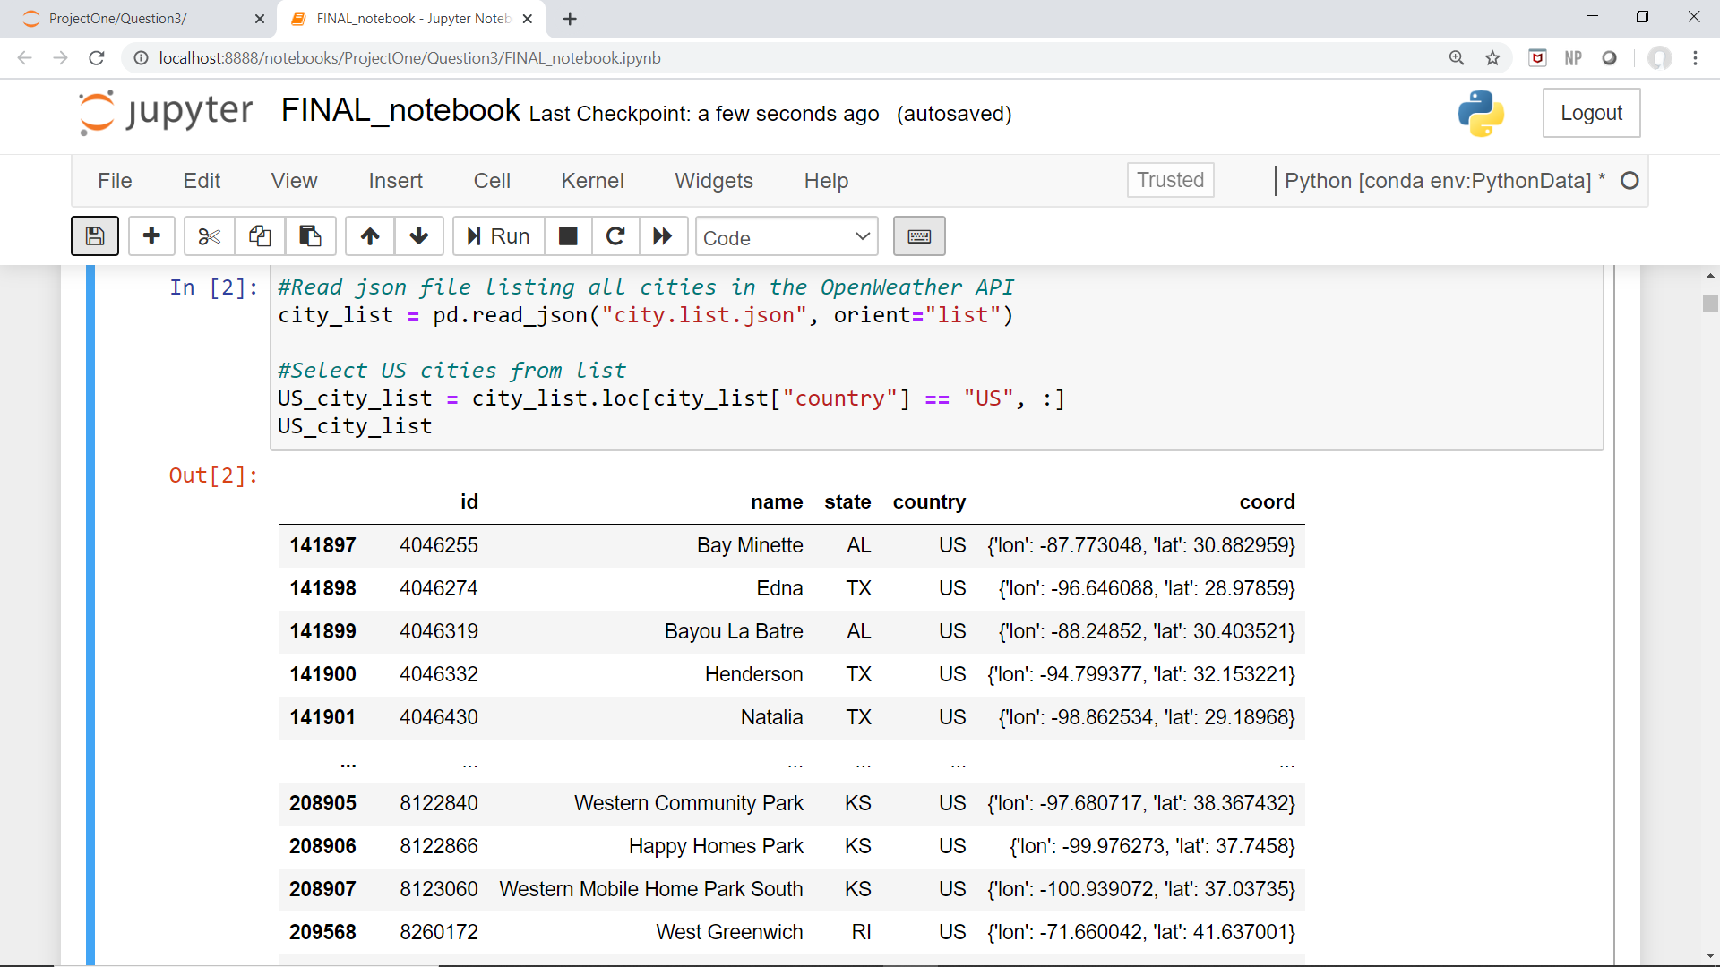
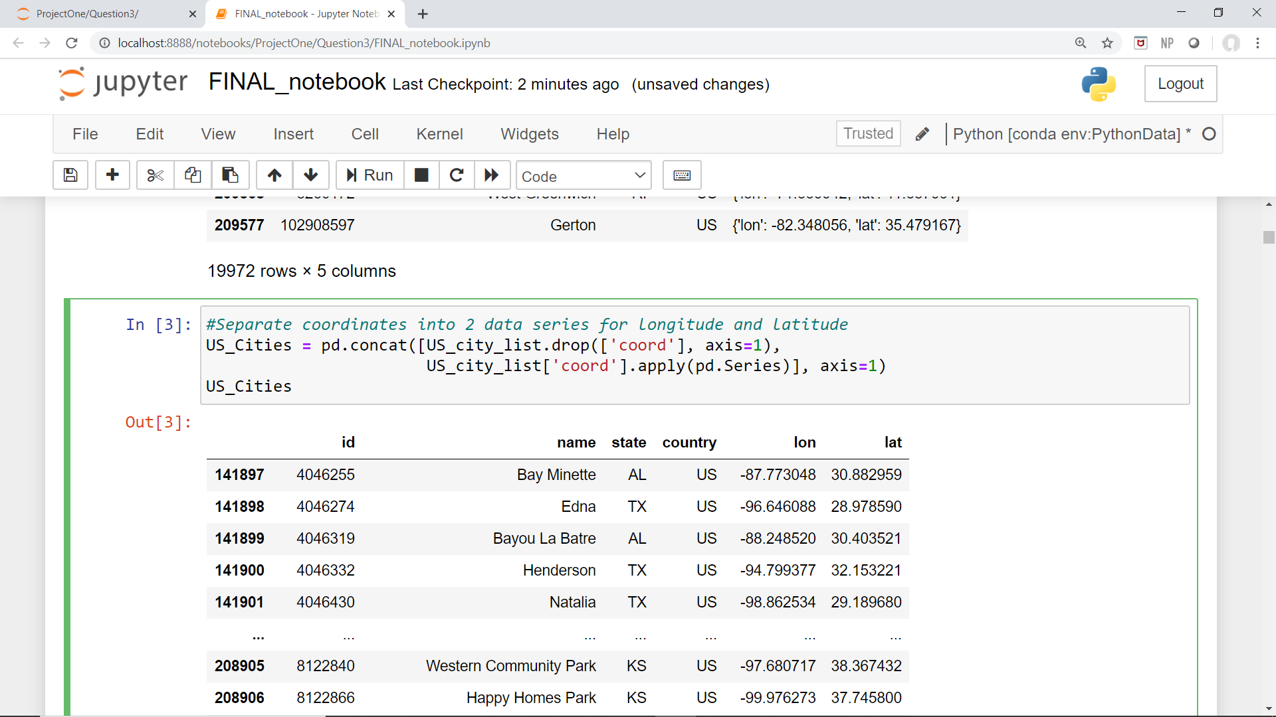
Jupyter Notebook
Import modules and passwords
Read JSON file with list of every city in OpenWeather 5 day history data set
Need to separate “coord” into latitude and longitude
Use .apply(pd.Series) to convert dictionaries to series

Slide 31
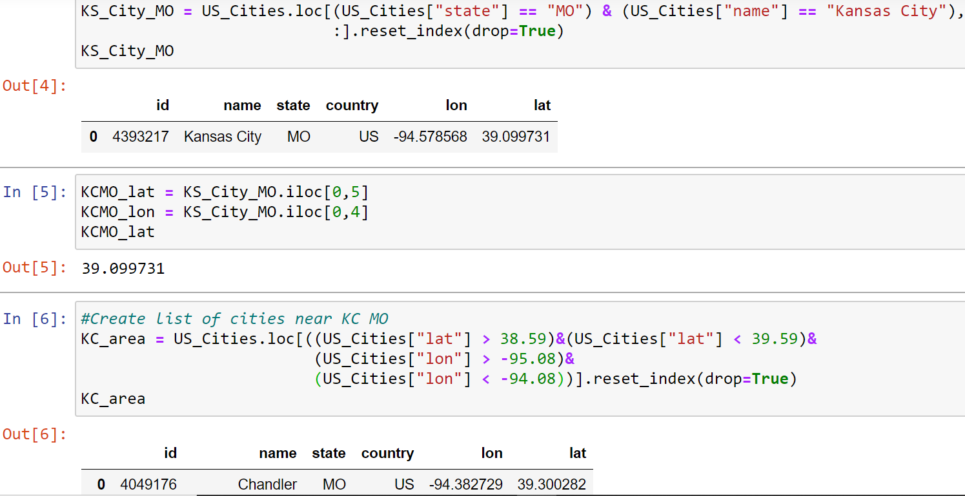
Find Kansas City, MO
Store coordinates in variables
Narrow list from US cities to only cities within +/- 0.5 deg latitude and longitude of KC, MO
Use name, lon, and lat data to query OpenWeather API for high temperatures over the last 5 days in KC, MO and the surrounding cities.

Slide 32
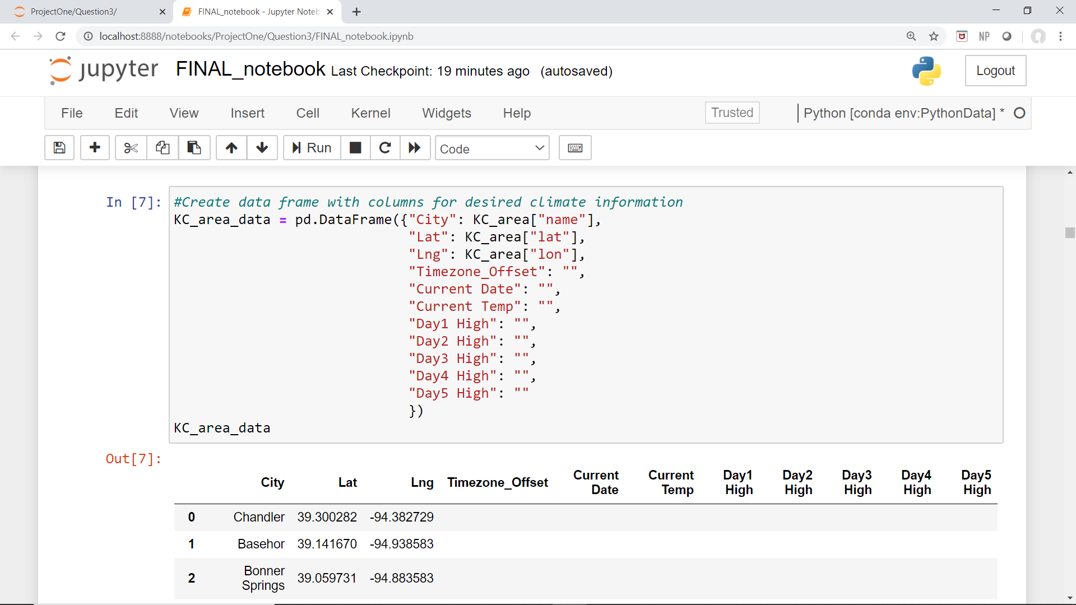
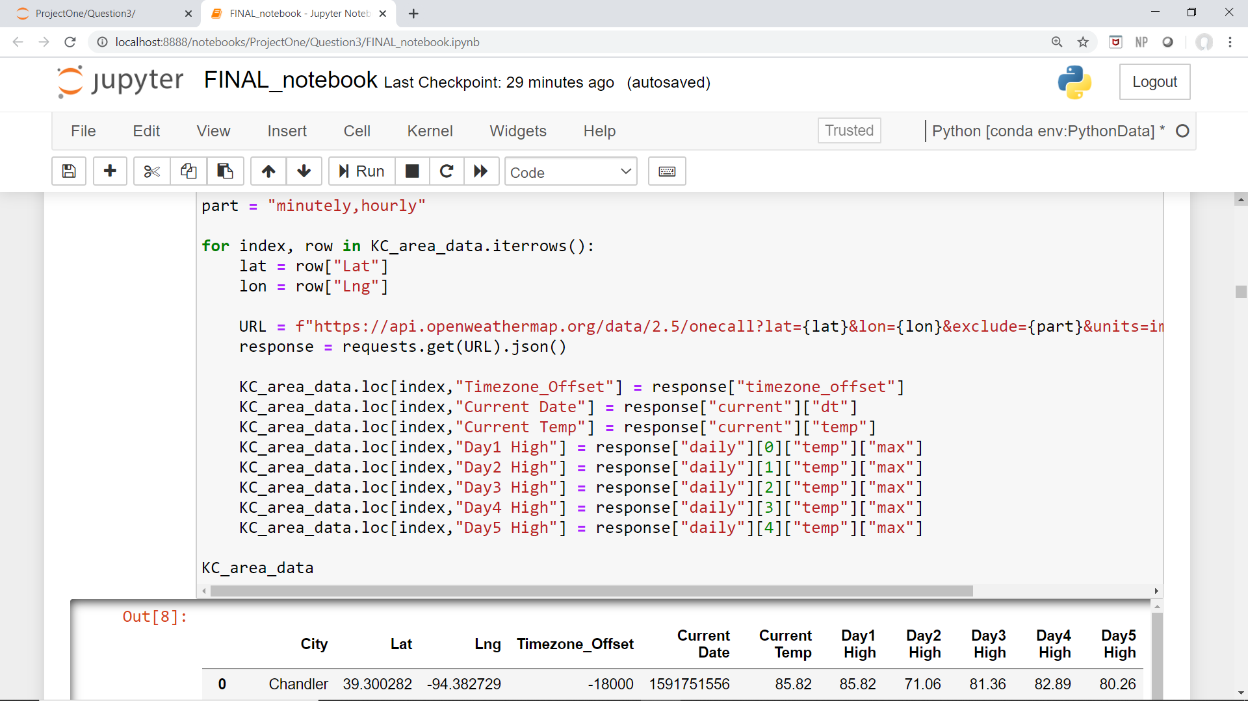
Create new dataframe to store weather data
Import OpenWeather API data

Slide 33

Compare location and temperatures of each city to downtown Kansas City
Locate KC, MO within dataframe
Calculate distance using latitude and longitude
Calculate change in temperature

Slide 34


Calculate distance in miles of each city from Kansas City, MO
Equations to convert change in latitude and longitude to distance.
Final dataframe used in analysis shown

Slide 35


Prepare distance and temperature change data for linear regression analysis.
Final result is a dataframe with 2 series of data showing distance and change in temperature.

Slide 36


Slide 37

R-squared = 0.24

Slide 38
Conclusions
The average temperature within 30 miles of downtown Kansas City, MO is 0.7 degrees cooler than downtown KC, with a mode of 0.6 degrees cooler and a standard deviation of 0.84.
Temperatures as you travel a distance away from Kansas City, MO decrease slightly the further you are from the city, but with a correlation r squared coefficient of 0.24, there is no true correlation between distance from KC, MO and temperature within the KC metropolitan area.
Assumptions: As you travel away from downtown Kansas City, the population density decreases. I did pull census data for population by zip code and plotted this on a map with temperature data. However, the visualizations were unclear and time constraints prevented further analysis with this data set.

Slide 39
Data limitations and Recommendations
Limitations:
Data is limited to Kansas City metro temperatures over the past 5 days. This is a very narrow scope of data.
Recommendations:
I recommend looking at more dates, seasonal trends, and expanding the dataset to investigate other large metropolitan area.
Challenges:
Population data: To address population density, I also queried population data from the census bureau. Census data was presented by zip code, so I used the latitude and longitude of each zip code to layer population density on a map with temperature markers. The data was difficult to discern because markers overlapped and covered the population density layer and the population density layer was so compact the data points overlapped a great deal.
Historical temperature data: I also looked at climate data from the National Oceanic and Atmospheric Administration database. This showed historical monthly averages from present dating by to the early 1970’s. However, upon investigation the “average” temperature for each month was derived from the monthly high and monthly low temperatures rather than averaging daily high temperatures. OpenWeather API historical data requires subscription fees, so I did not use this source to explore historical temperature data.

